Slide 1
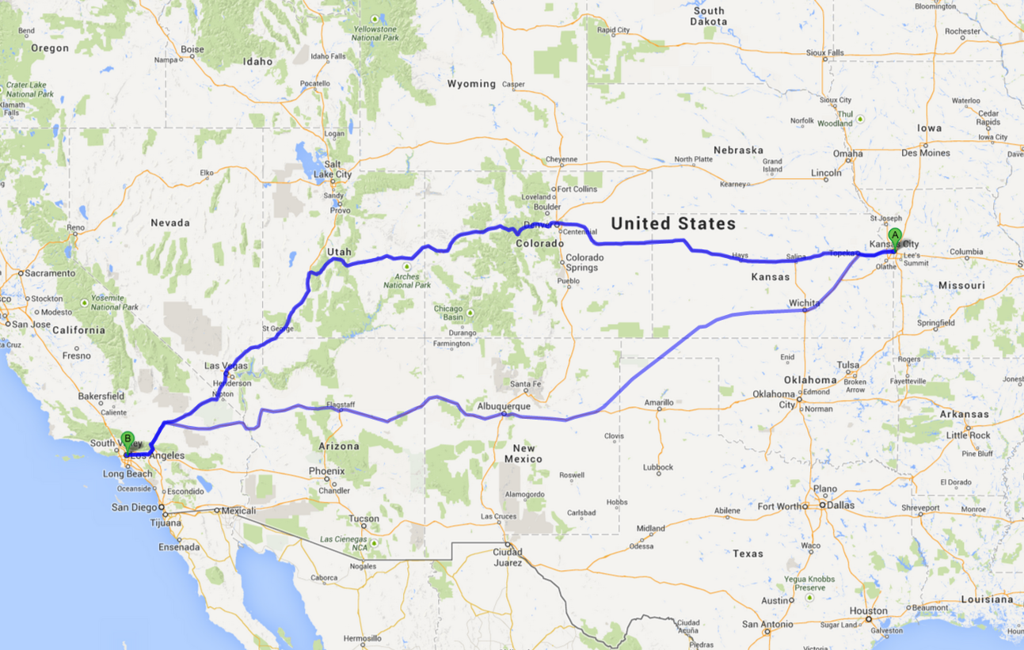
The Right Amount Of Planning

Slide 2


































Titanium Sponsors
Platinum Sponsors
Gold Sponsors

Slide 3

Who Is This Guy?
Practice Director / Paige Technologies
@jonathanfmills
Jonathanfmills.com

Slide 4


Slide 5
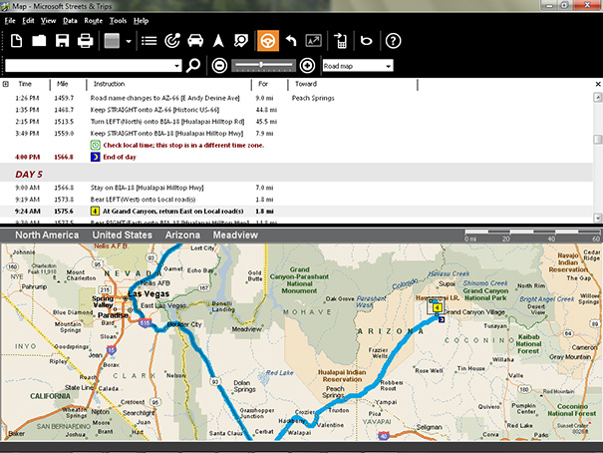

Slide 6
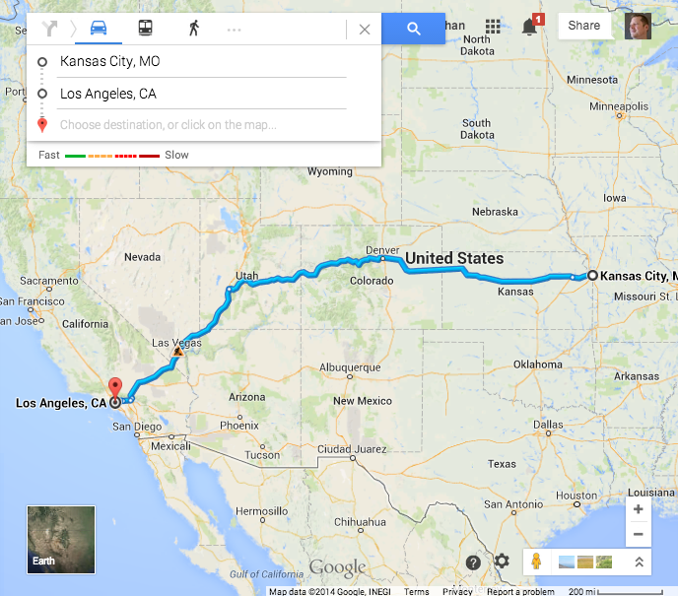

Slide 8


Plan just enough to get you going in the right direction….
With a clear understanding of
where you are going.

Slide 9
Who
What
When
Where
Why

Slide 10
Why are we here?
When is it due?
What are we doing?
Who is involved?
Where is it going?

Slide 11
Why are we here?
When is it due?
What are we doing?
Who is involved?
Where is it going?

Slide 12
Who is using the system?
What are they doing now…..

Slide 13
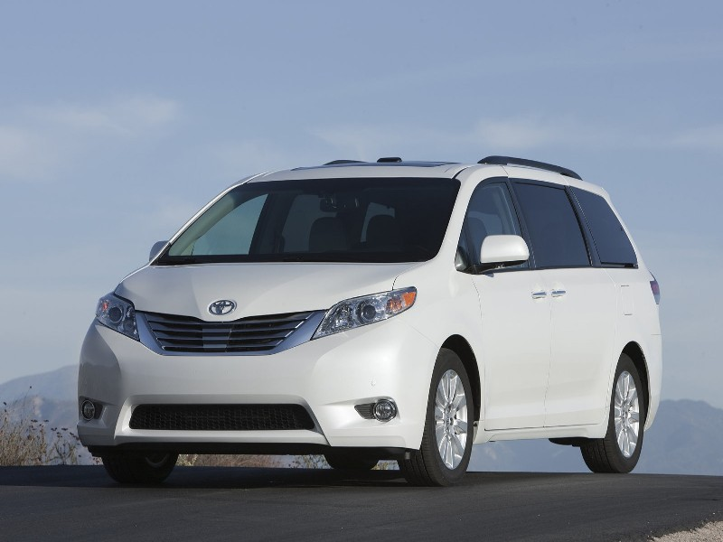
Notes:
The Toyota Way.
The chief Engineer Yuji Yokoya charged with designing the 2004 Toyota Sienna
They lived in Japan, they had no concept of North America
They drove through every state in the US, Mexico and Canada
What they found
Higher crowned roads in snowy Canada led to excellent drift control,
high winds in Mississippi made him engineer for stability,
Santa Fe's narrow streets enforced a tight turning radius.
His observations at Home Depot led to a cargo bay that can take a 4x8' plywood sheet—
Observations of how Americans eat and drink in the car much more than Japanese produced a car with 14 cup holders!

Slide 14
Why are we here?
When is it due?
What are we doing?
Who is involved?
Where is it going?

Slide 15
Due Date?
What Happens the Next Day?

Slide 17
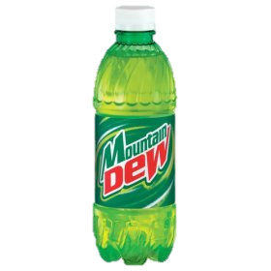
Immediately!

Slide 18
As Soon As Possible

Slide 19

Enjoy the ride….

Slide 20
Know the why
and the when,
before we worry about
the what….

Slide 21
Why are we here?
When is it due?
What are we doing?
Who is involved?
Where is it going?

Slide 22
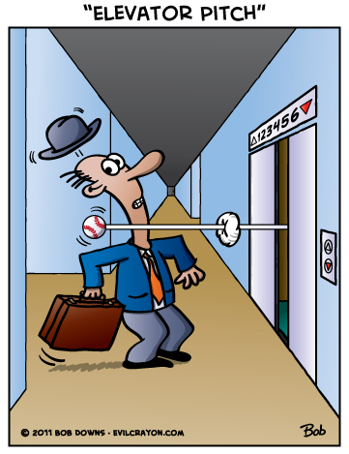
Elevator Pitch
Notes:
As a result
Clarity
Think about the customer
It gets to the point

Slide 23
For [Customer]
Who needs to [Need]
The [Product Name]
Is a [Category]
That will [Key Benefit]
Unlike [Primary Alternative]
The new system will [Differentiator]

Slide 24

Design a Box
Notes:
Design a box
What are the key product benefits?
Slogan?
Build a box…

Slide 25
What are the major bullet points?

Slide 26
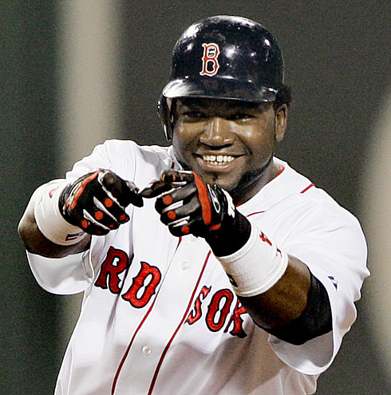
What’s your MVP?

Slide 27
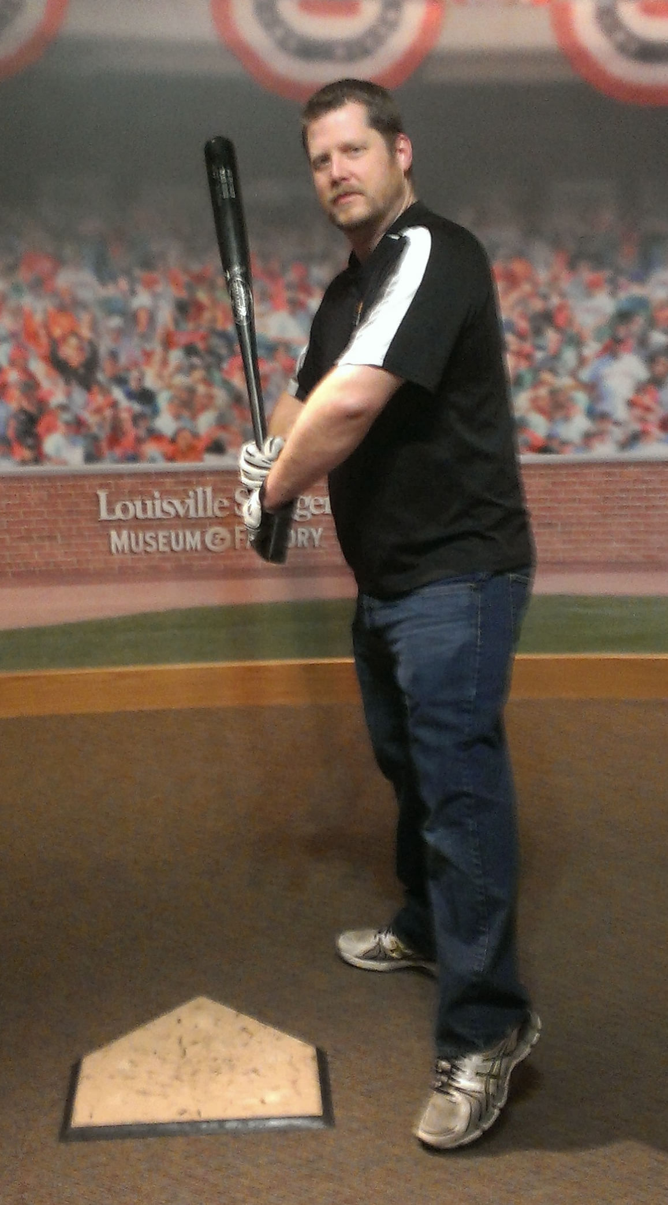
What’s your MVP?

Slide 28

Build a stack of work…..
MVP
Everything Else
Notes:
Map out what you are thinking
What are you using…
What are the maybes?
Why do it?
Sets expectations around tools and technologies
Visualizes assumptions around boundaries
Communicates risk
show it to the neighbors
Why?
Let them call you on bad decisions or assumptions
You are a hammer… Let the other tools help with solutions
Get their insight

Slide 29
Why are we here?
When is it due?
What are we doing?
Who is involved?
Where is it going?

Slide 30
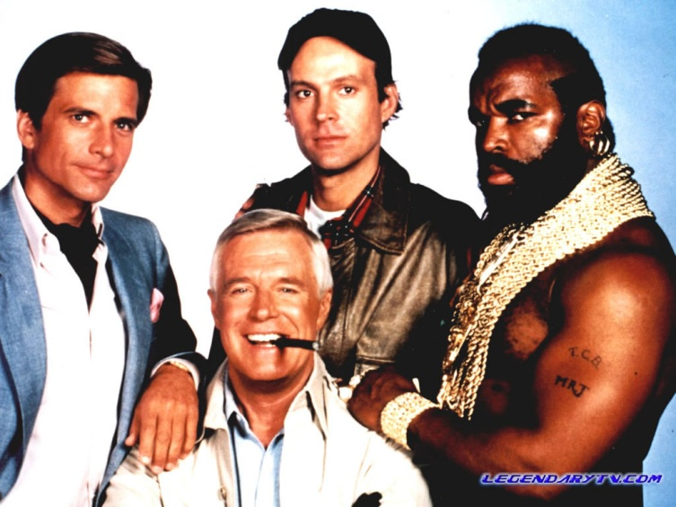
Who Is Your A Team?
Notes:
Who is you’re a team?
UI?
Dev?
PM?
Test?
Customer?

Slide 31

Meet Your Neighbors
Notes:
Who is involved in the project?
Who is core?
Who is impacted?
Who impacts us?
Call them together, and get coffee and donughts….
Go over the elevator pitch and the not list.

Slide 32

Who Is In Charge?
Notes:
Who calls the shots?
Who is the product owner?

Slide 33
Why are we here?
When is it due?
What are we doing?
Who is involved?
Where is it going?

Slide 34

Questions?

Slide 35
Who Is This Guy?
Director R&D / Paige Technologies
@jonathanfmills
Jonathanfmills.com

